Slide 1
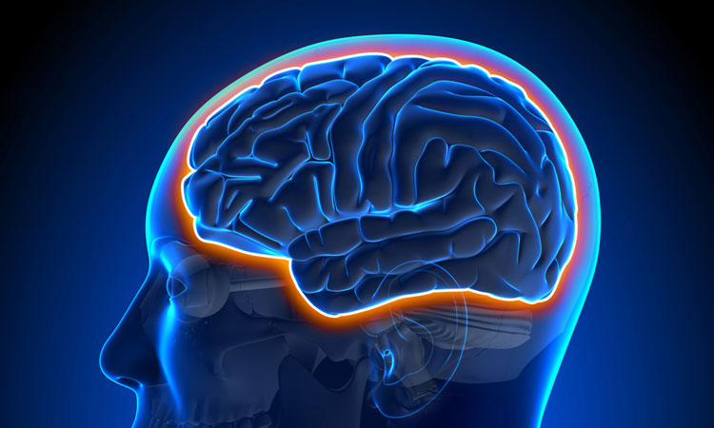
Concussion
Dr Sarah Williamson
Notes:
https://www.rugbypass.com/news/kyle-sincker-brutally-knocked-out-just-minutes-into-rugby-world-cup-final/
https://www.youtube.com/watch?v=WiU6rhOwjg4

Slide 2

What Is a Concussion?
A Traumatic Brain Injury
A concussion can happen when a hit to your head, neck, or body sends force to your brain and temporarily throws off how it works.
Symptoms May Be Delayed
You might feel okay at first. Symptoms can show up minutes or even hours later, so it’s smart to stay alert after any hit.
Recovery Is Usually Possible
Most athletes get back to normal within days, and some take a bit longer — the key is giving your brain the right time and care to heal.

Slide 3
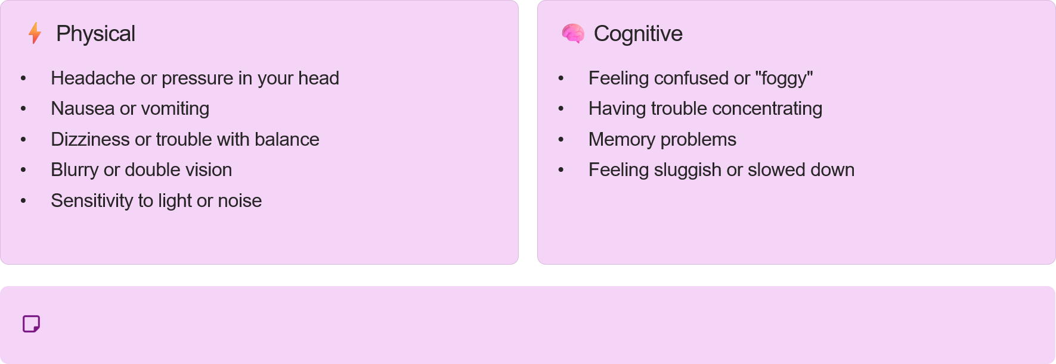
Signs/Symptoms you might notice in yourself

Slide 4
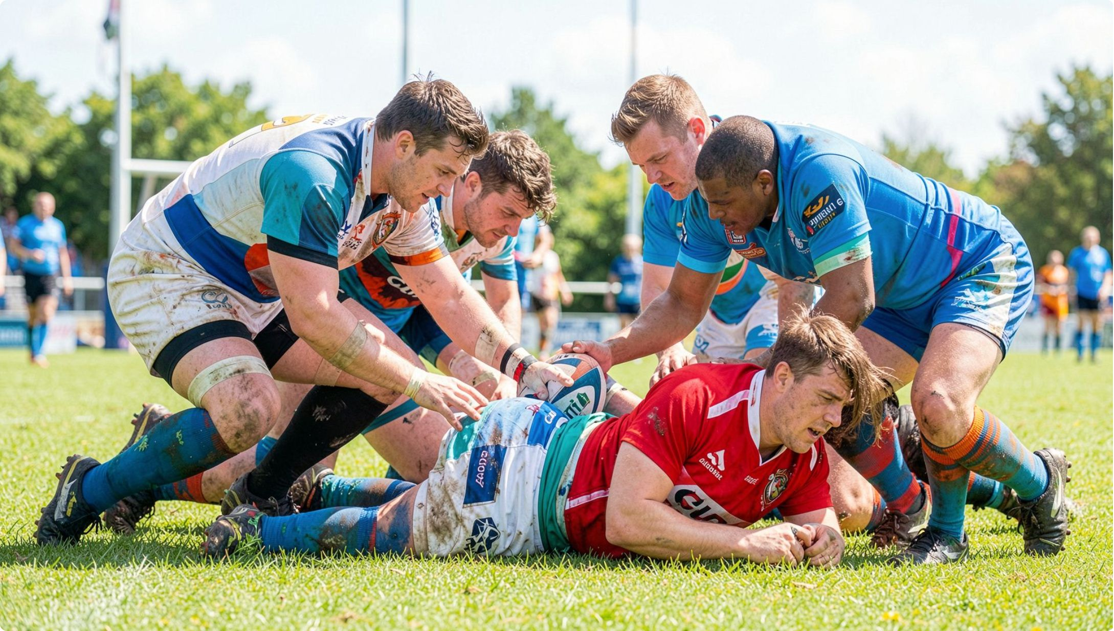
Signs/Symptoms you might notice in your teammates
If you notice something feels off, trust your instincts - catching these signs early could help protect a teammate from something more serious.
They seem dazed, stunned, or confused
They forget instructions or seem disoriented
You might notice they seem unsure of the score,
their position, or what’s happening in the game.
Maybe they can’t remember a play you just heard,
or they’re looking blank and out of sync.
They move clumsily or lose balance
They respond slowly or seem foggy
They may look a little unsteady on their feet
or not move like they normally do.
You may notice delayed answers or
that they’re having a harder time processing what’s being asked.

Slide 5
Why You Can't Play Through It: The Real Consequences
It’s not about being weak; it’s about protecting the most vital part of you.
Ignoring concussion symptoms puts your future at risk.
Immediate Risks: Second Impact Syndrome
Short-Term Effects: Prolonged Recovery
A rare but devastating condition, Second Impact Syndrome (SIS) occurs when a second concussion happens before the brain has fully healed from the first. This can lead to rapid and severe brain swelling, often resulting in permanent brain damage or even death.
Trying to play through a concussion can significantly extend your recovery period. Symptoms like persistent headaches, dizziness, fatigue, and difficulty concentrating can worsen and last much longer, impacting your academic performance and daily life.
Long-Term Concerns: Cumulative Damage
Repeated concussions, especially if not fully healed, increase the risk of cumulative brain damage. This can lead to chronic issues such as depression, anxiety, memory problems, and even increased susceptibility to neurodegenerative diseases like CTE, MND, Parkinsons and Alzheimer’s/Dementia later in life.

Slide 6
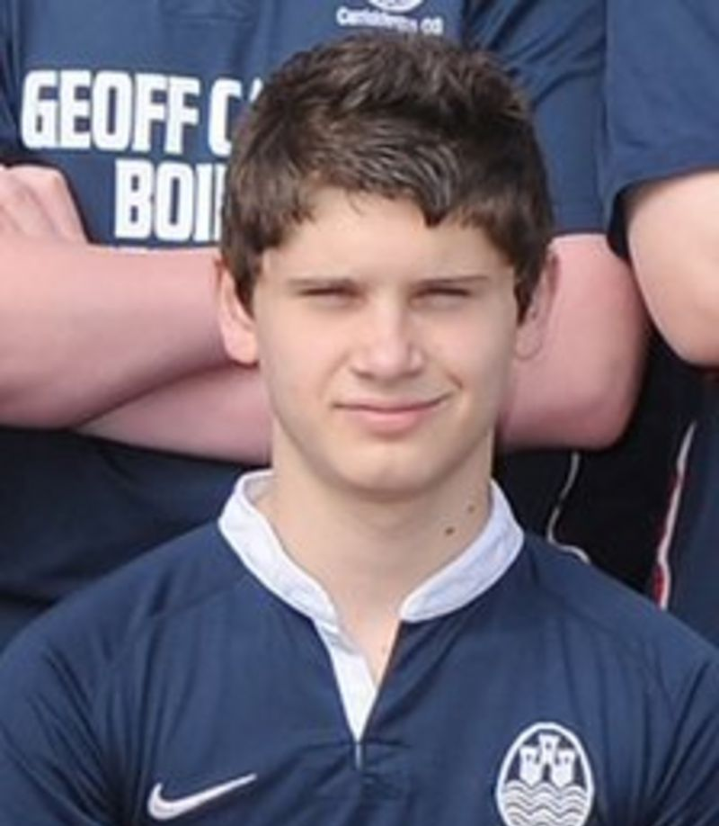
Ben's Legacy

Slide 7
What should I not do?
Stay silent
Hide it and carry on playing – be open and honest
Drive
Drive – You should not drive for a minimum 24 hours post concussion
Drink
Drink – No alcohol consumption for a minimum 24 hours post concussion
Pain Relief
Take painkillers

Slide 8
What should I do?
Remove yourself from the game – you only get 1 brain!
Get yourself checked out – hospital or urgent care
Speak to the first aider at the game
Ensure you follow the guidelines to return to sport
Drop into the Sports Injury Clinic

Slide 9
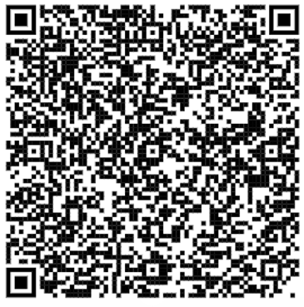
Take home messages
You only get 1 brain – Take care of it!
Tell a member of staff or see the first aiders at your game/meet
Book in at the Sports Injury Clinic in VH for assessment, rehabilitation and support to get you back to your sport
Complete the RTS protocols as outlined by BUCS, GRAS and Government Guidelines
QR Code for the Sports Injury Clinic – VH.0.21a
Notes:
In Professional Rugby Union a temporary substitution for up to 10 minutes allows for an off-field evaluation where the diagnosis is not clear.

